Slide 1
The Center for Inclusive Education Presents
Graduate School Preview Day
The PhD: A Path to Success
Follow us on Twitter: @CIEStonyBrook
Follow us on Facebook: Stony Brook University Center for Inclusive Education
#GSPD19

Slide 2
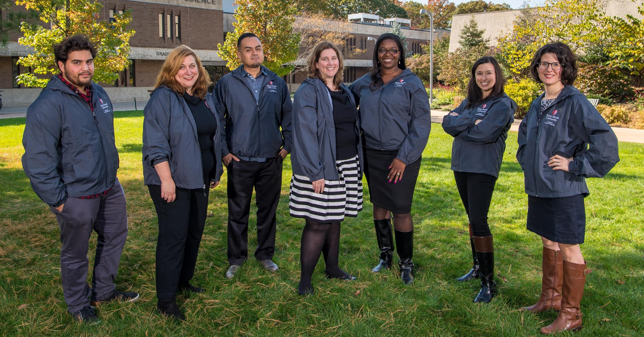
The Center for Inclusive Education Staff
Center for Inclusive Education

Slide 3

Funding your Doctoral Degree
Center for Inclusive Education

Slide 4
Fact: You can and should play an active role in securing graduate school funding
Discuss funding opportunities during the application process
You are responsible for being aware of any deadline dates for eligibility for institutional and/or external funding
Eligibility requirements often apply and can include: Being a US Citizen or Permanent Resident, degree being sought, full time enrollment, etc.
Center for Inclusive Education
Notes:
Deadlines will vary between institutions, and even between opportunities within a single institution

Slide 5
A Lexicon of Graduate School Funding
Tuition Scholarship – Covers the cost of tuition
Stipend – A form of salary provided in exchange for teaching (TA), research (RA) or administrative support (GA)
Fellowship – Financial support given with no obligation for the student to engage in teaching or research; Can be internal or external
Full Funding – Tuition scholarship plus some combination of TA, GA or RA and possibly fellowship funds
Internal Funding/Institutional Money – Funding provided by the University
External Funding – Funding provided by an external funding agency; agencies can be public (Department of Energy, National Science Foundation, etc.) or private (Gates Millennium Scholars) **External money is often portable
Center for Inclusive Education
Notes:
* Fees are a standard cost of graduate study and are rarely covered by an award package

Slide 6
National Fellowships
Apply as early as senior year for external funding opportunities:
National Science Foundation Graduate Research Fellowship
Sloan Fellowships
NASA Graduate Research Fellowships
DOD SMART
DOE Science Graduate Fellowships
Ford Foundation Fellowship
Fulbright Fellowship
Javits Fellowship
Center for Inclusive Education

Slide 7
National Fellowships
Dozens more...
www.PathwaystoScience.org: STEM
www.h-net.org: Humanities and Social Sciences
The Foundation Center: 79 5th Avenue New York, NY
SBU’s Graduate School Website
Center for Inclusive Education

Slide 8
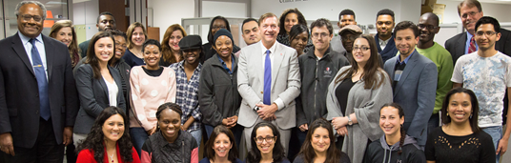
Building Community
The Center for Inclusive Education at Stony Brook University
An umbrella unit of the Graduate School
Formally established in 2002 with one program; today hosts 7 programs, including SUNY Graduate Diversity Fellowship Program
Engages faculty, staff, campus leaders and national collaborators in developing programs to support the research, teaching and professional development of students and postdocs
Center for Inclusive Education
Notes:
Bringing graduate students together across disciplines can
Provide a solid support network and a sense of belonging through shared experiences
Encourages and enables interaction and the free exchange of ideas
Improves quality of life
*such communities are vital to retention and degree completion

Slide 9
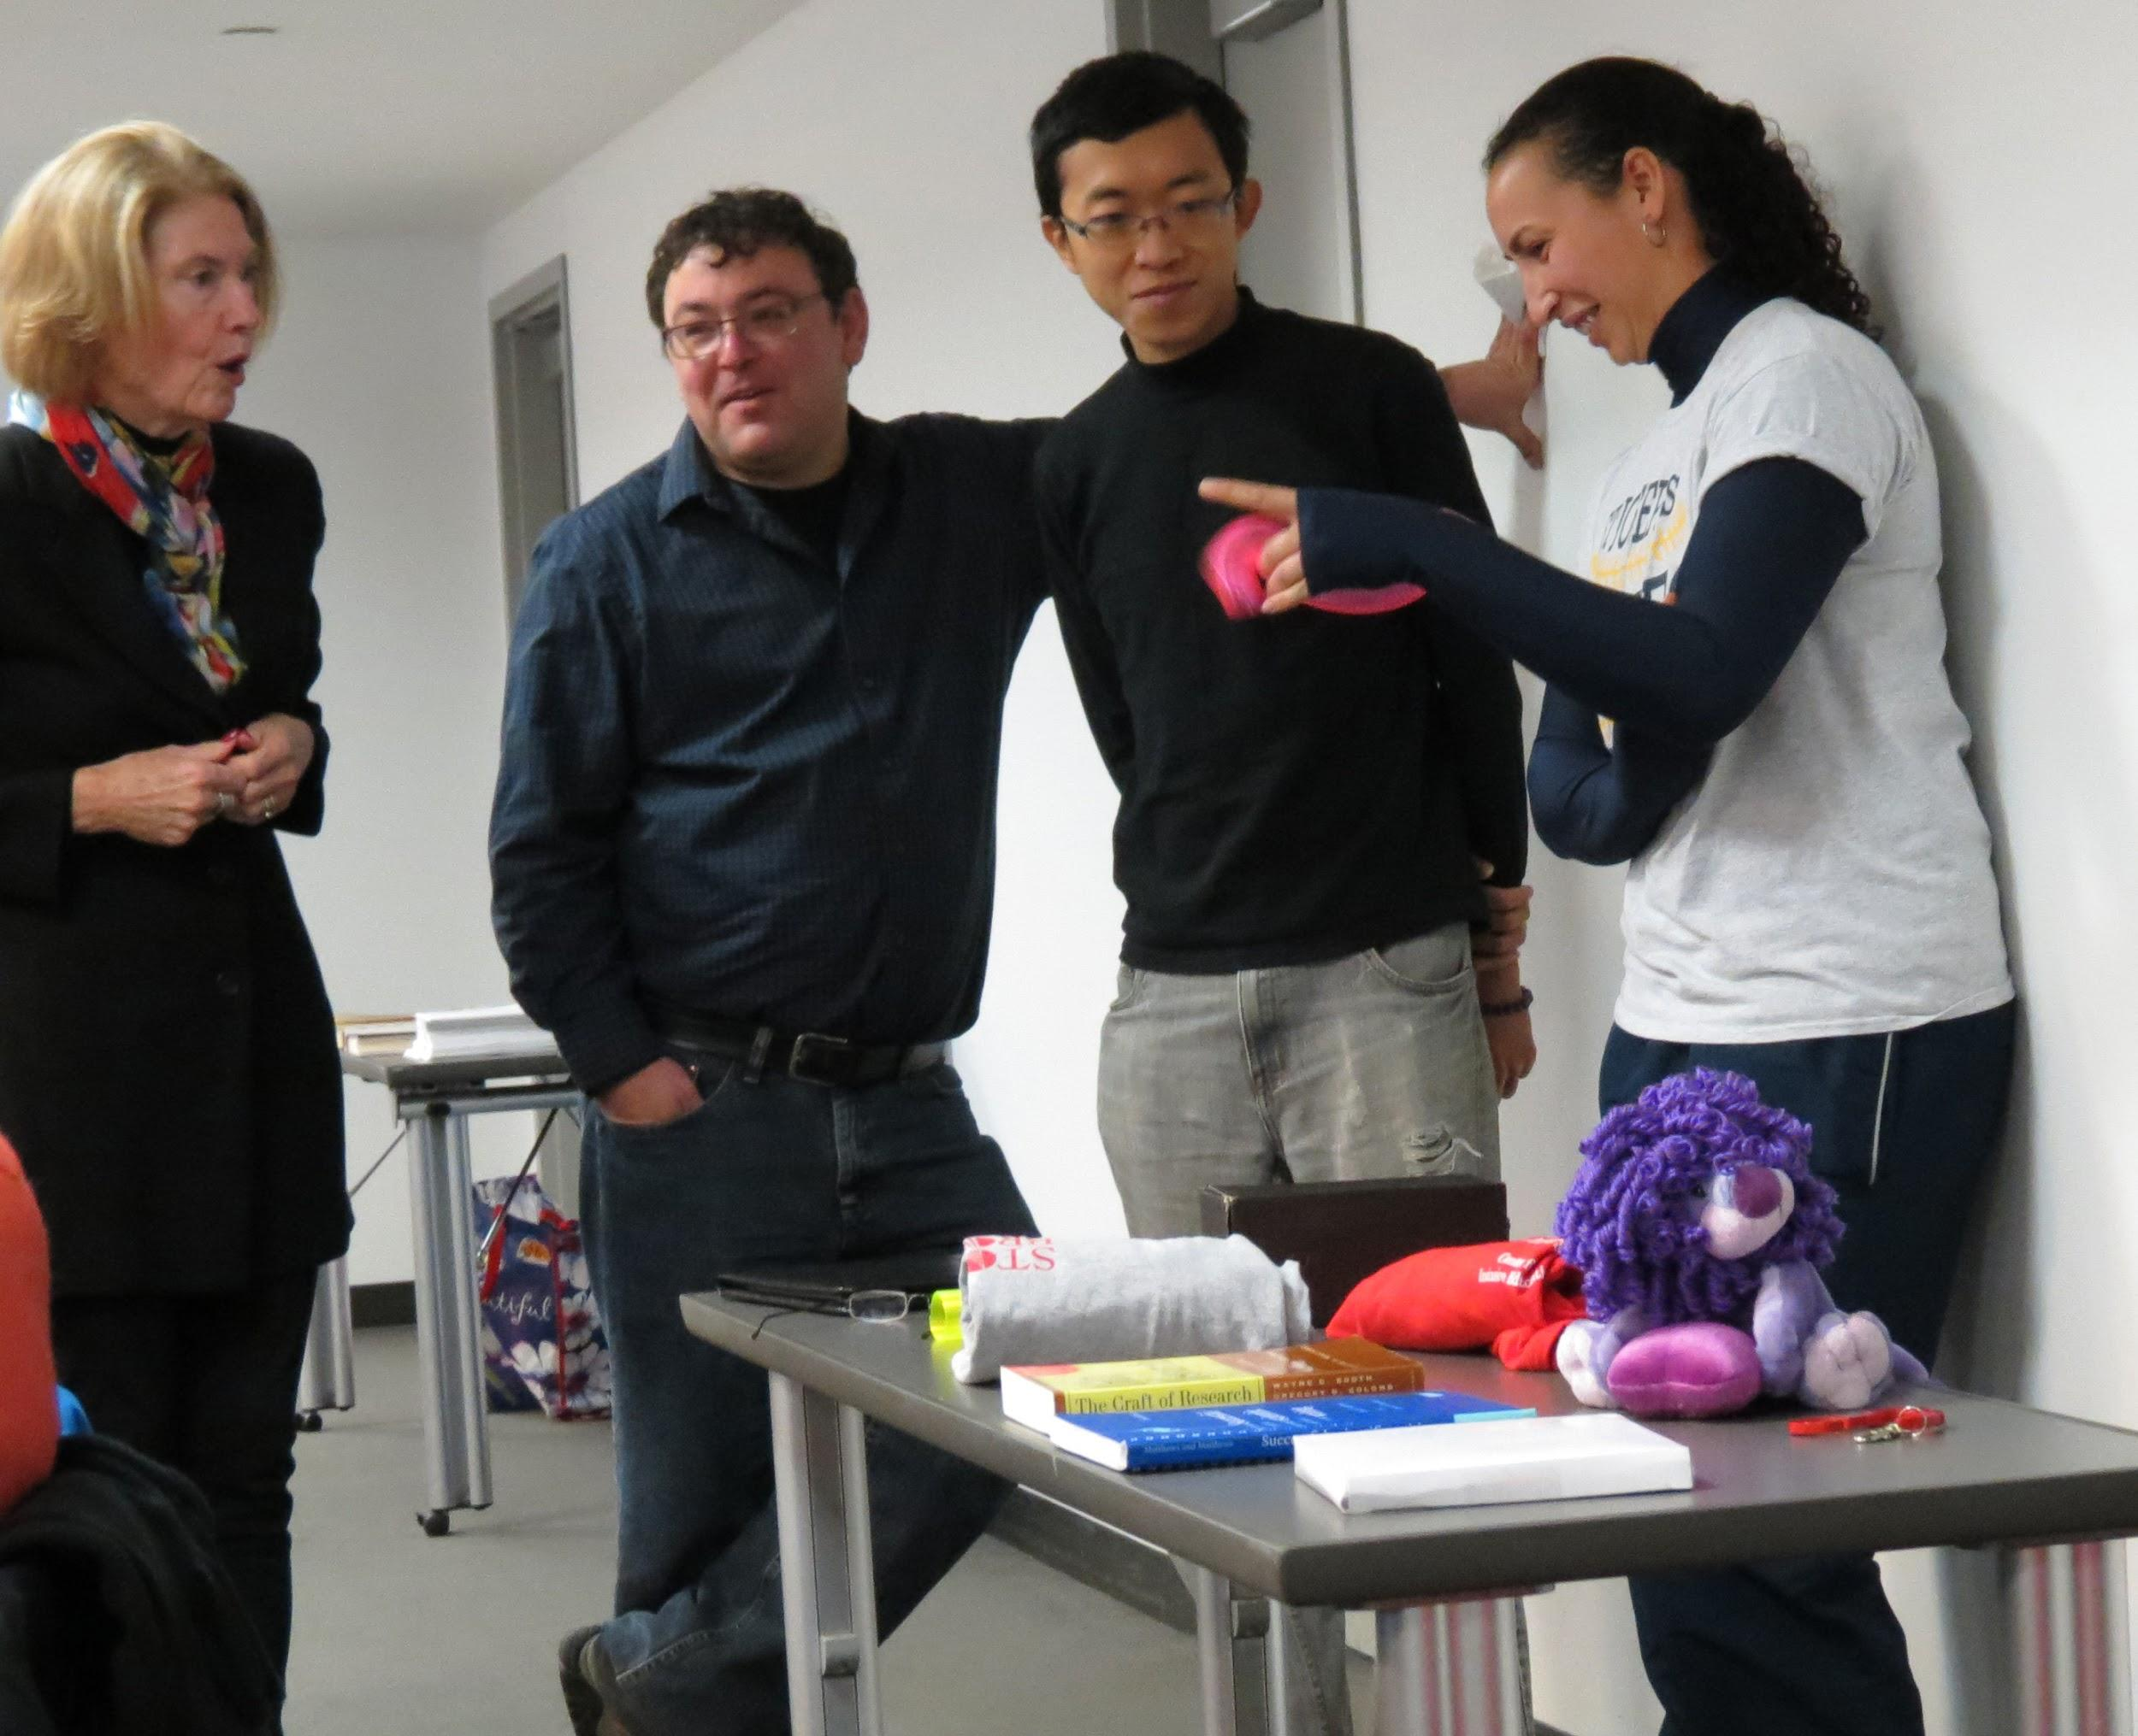
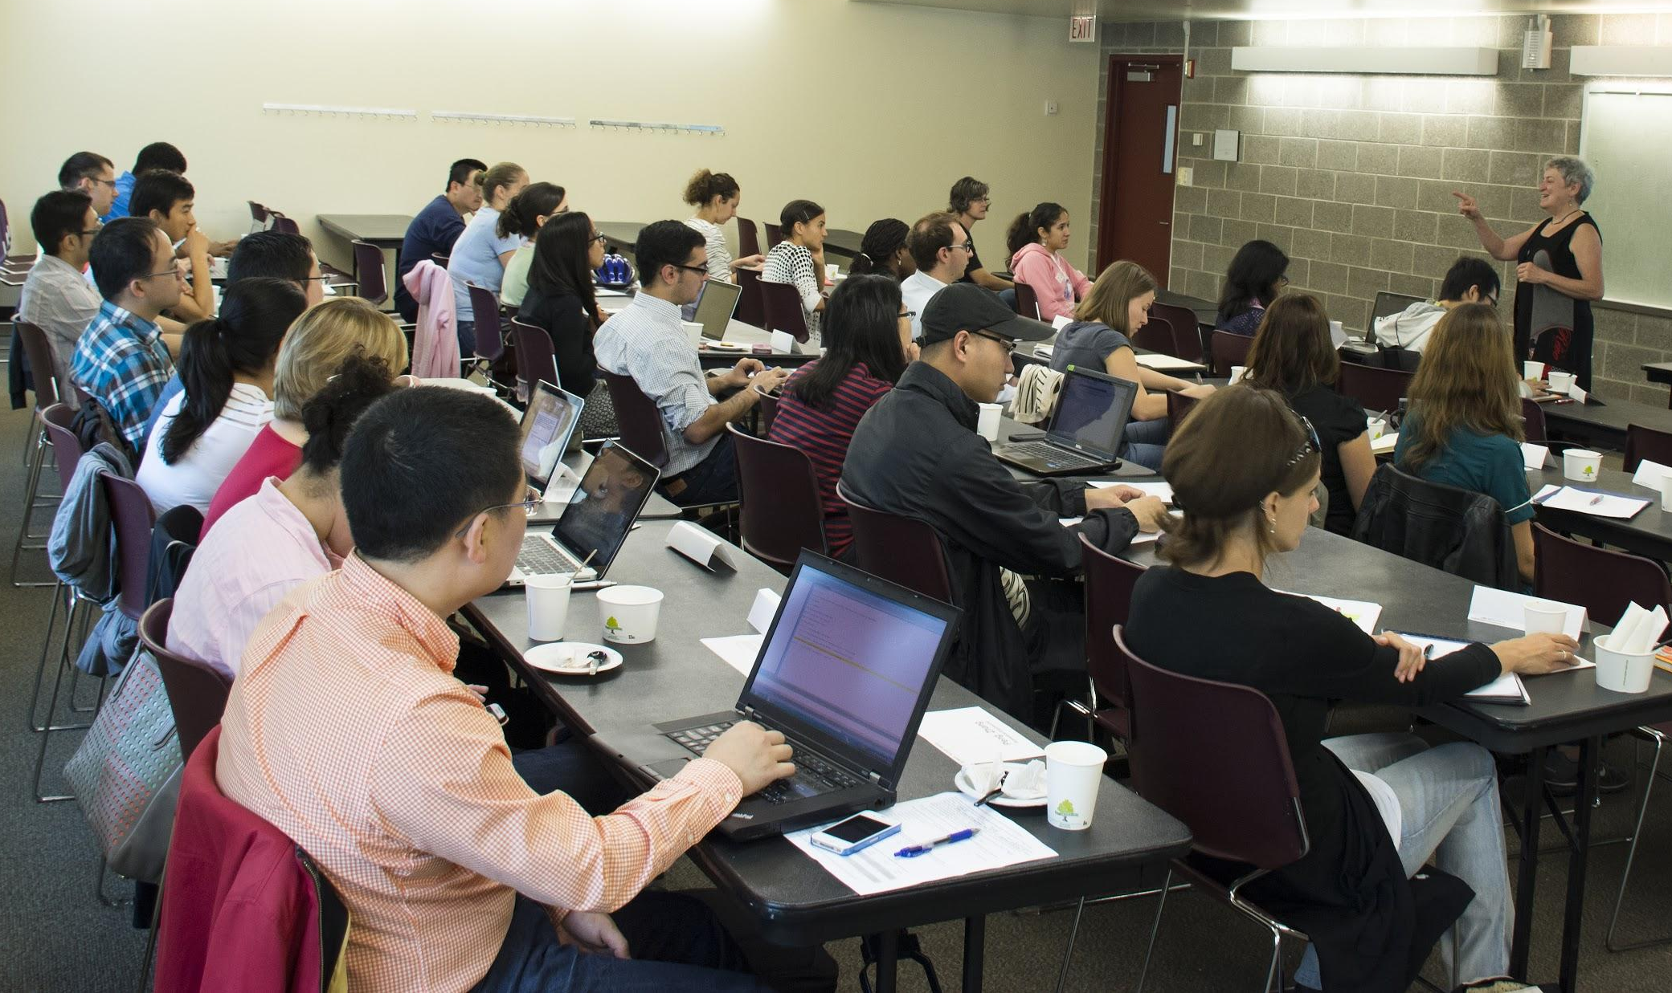
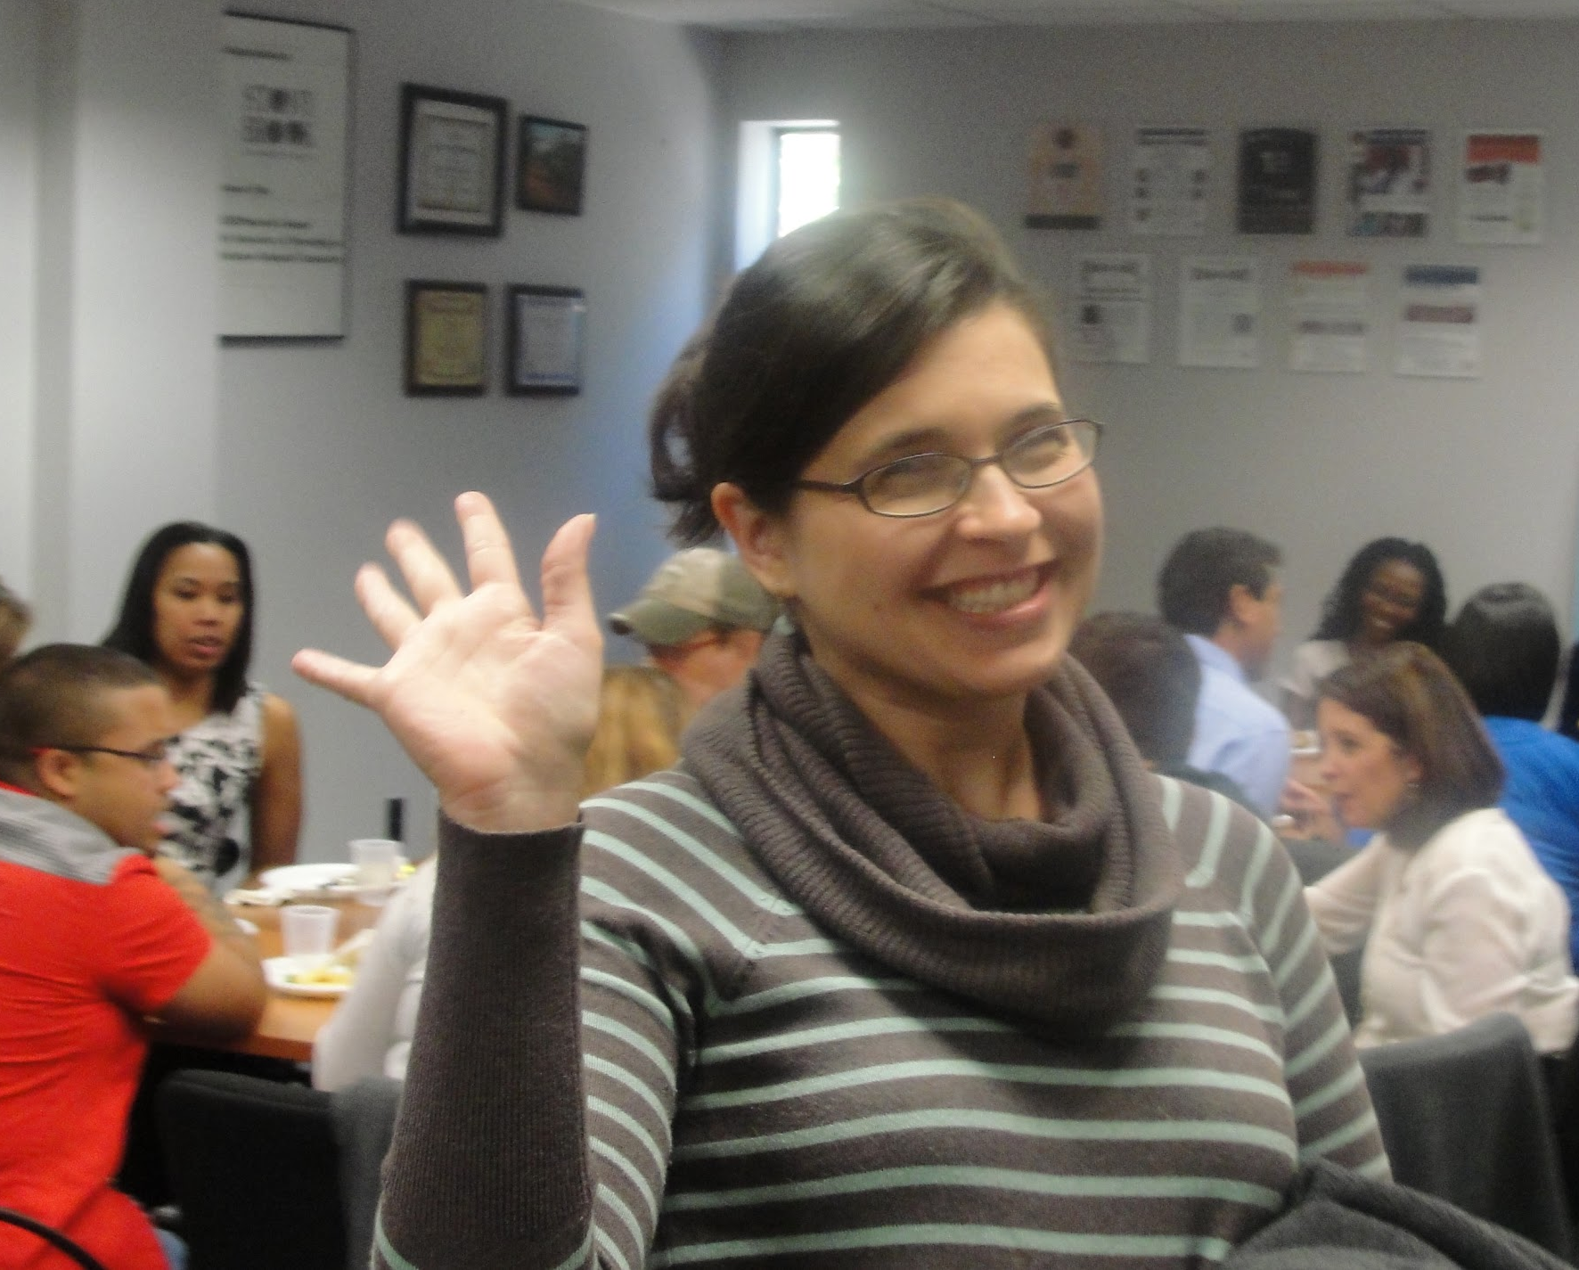
Center for Inclusive Education
Academic Enrichment, Professional Development, Mentoring & Community Building
Center for Inclusive Education
Notes:
The Center for Inclusive Education designs and administers innovative programs and activities to promote the success of our underrepresented undergraduate, graduate and postdoctoral scholars across STEM and non-STEM disciplines.

Slide 10
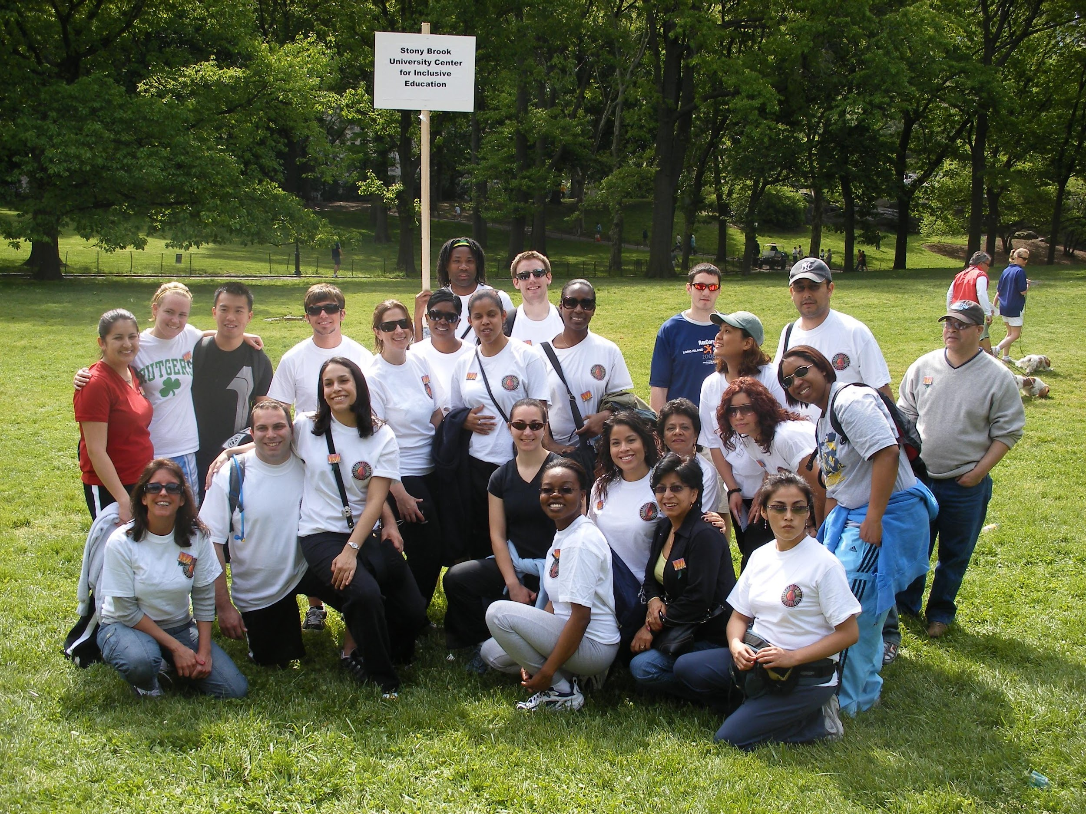
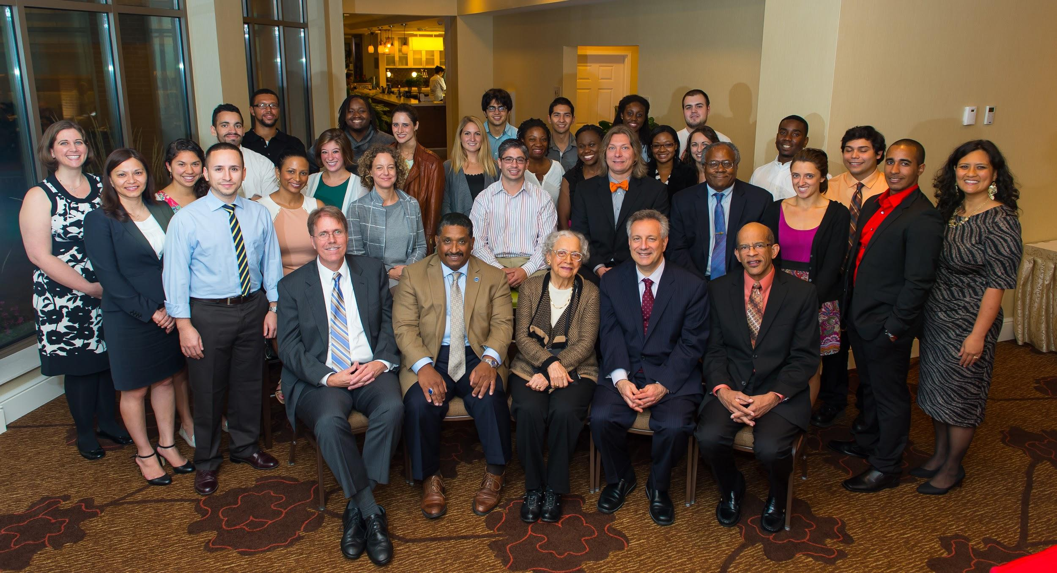

Dr. W. Burghardt Turner Fellowship Program
$50,000 over 5 years +TA/GA/RA
Full tuition
Conference Travel + Summer Research Funding
Funded by SUNY Office of Diversity, Equity and Inclusion
Eligibility
Exceptionally qualified UR doctoral students
US Citizen or Permanent Resident
*Nomination Based

Slide 11
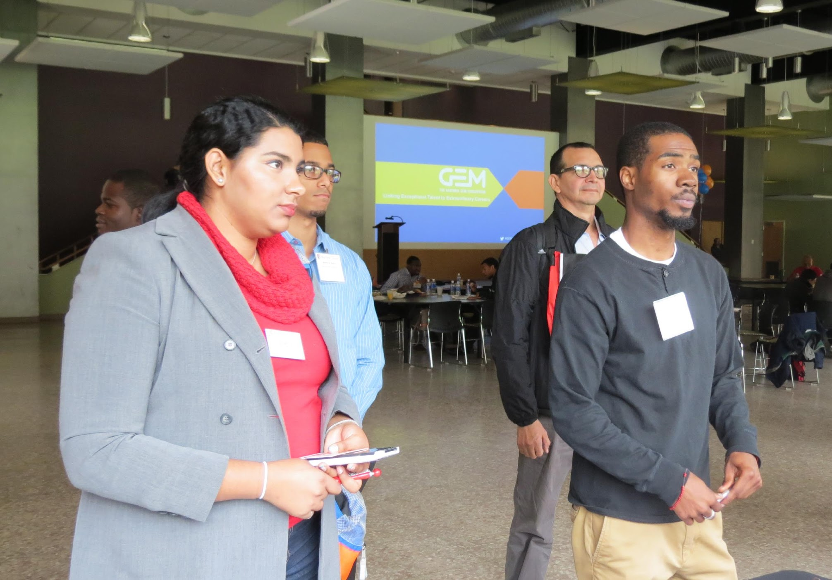

National GEM Consortium
Full tuition scholarship + full fees
Industry experience
Access to GEM network and job opportunities database
Apply by November 13: www.gemfellowship.org
Eligibility
US Citizen or Permanent Resident
STEM major
Master or PhD student
URM scholars who desire industry experience

Slide 12
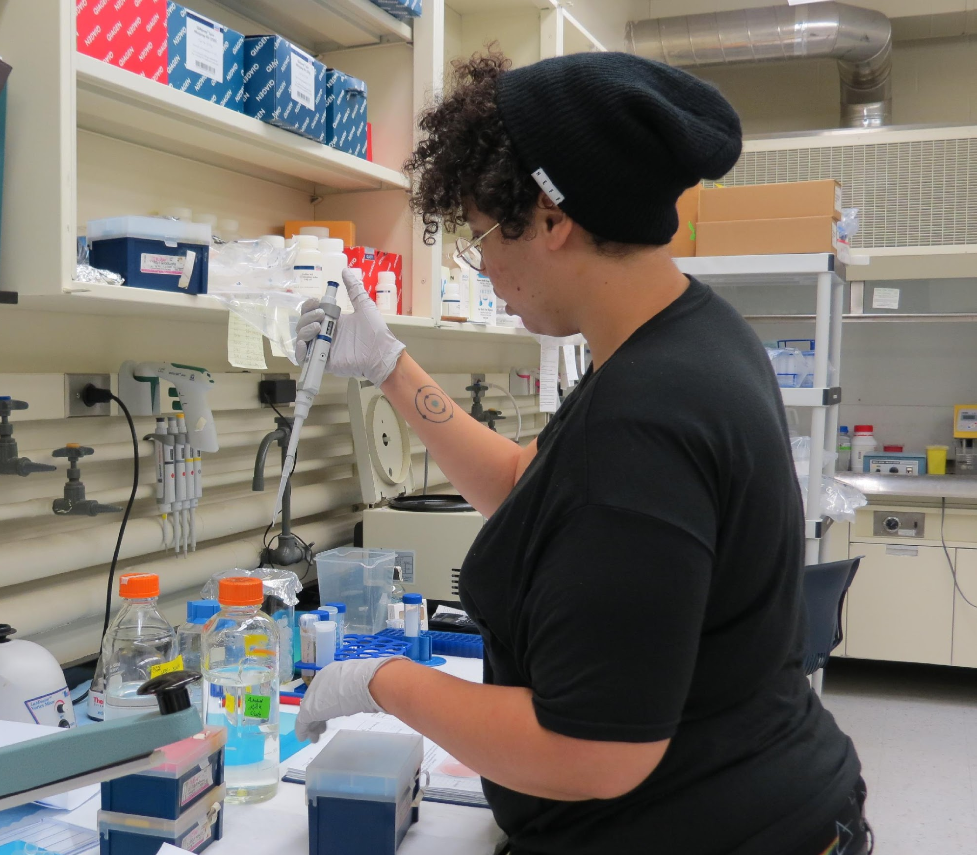
NIH IMSD-MERGE: Maximizing Excellence in Research for Graduate Education
Funding all 5 years (1 IMSD + 4 Departmental)
Academic and Professional Development:
  Summer Boot Camp
  Peer-Lead Team Learning
  Mentor Support
  Professional Preparation Series
Eligibility
US Citizen or Permanent Resident
URM scholar
Acceptance into PhD program in Biological/Biomedical Sciences
No application

Slide 13
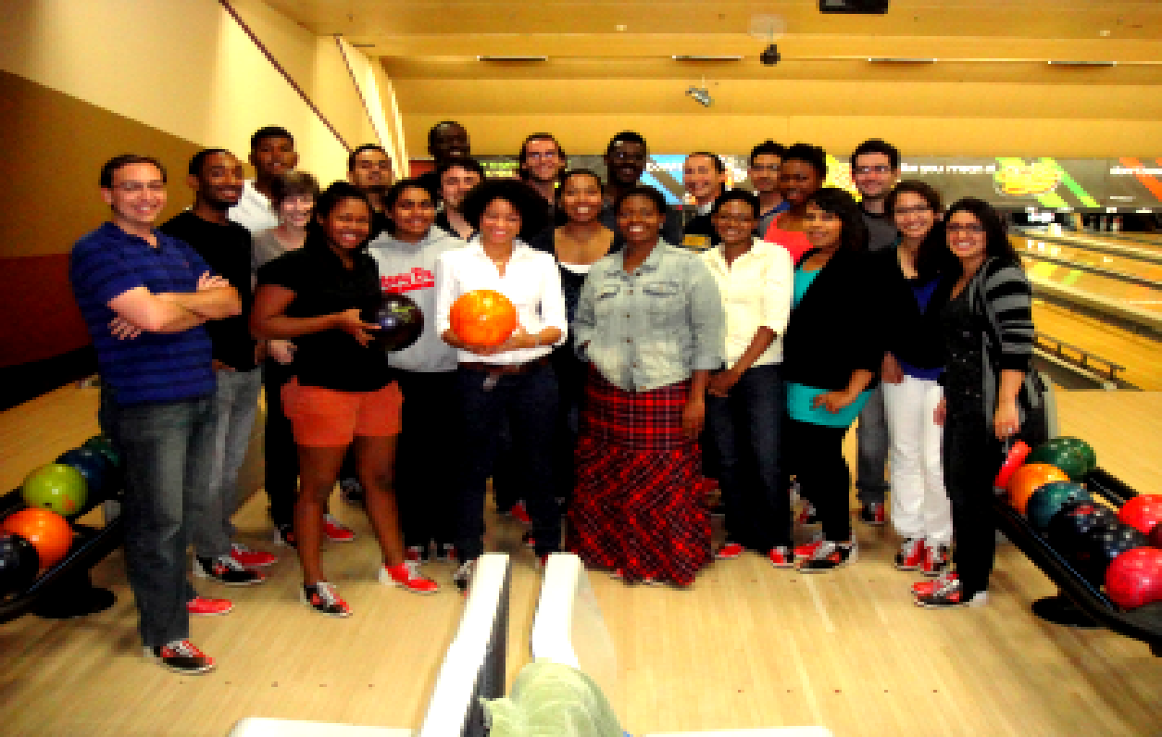


NSF LSAMP BD: Bridge to the Doctorate
$32,000 annually (for first two years)
Tuition, fees + health insurance
Mentoring by advanced graduate students/post-docs
Participation in professional conferences and meetings
Eligibility
Participated in LSAMP program
U.S. Citizen or Permanent Resident
GPA 3.0 +
Acceptance to STEM grad program at Stony Brook
Want to pursue a doctoral degree in a STEM discipline

Slide 14

Graduate Council
Fellowship
Exceptionally qualified doctoral applicants or MFA students
US Citizen or Permanent Resident
$50,000 over five years in addition to TA/GA/RA up to $32,000 annually
Email gradfinance@stonybrook.edu with questions
Center for Inclusive Education

Slide 15
Office of Graduate and Postdoctoral Professional Development
External Scholarships and Fellowships Advising:
Specific advice on external awards our office supports directly.
Group advising, extended “Boot Camps”, writing and essay review workshops.
Valuable professional skills development regardless of the outcome!
Career Preparation and Skills Development
PhD Career Ladder Program and other career planning
Practical skills development workshops
Three Minute Thesis competition and research communication training

Slide 16
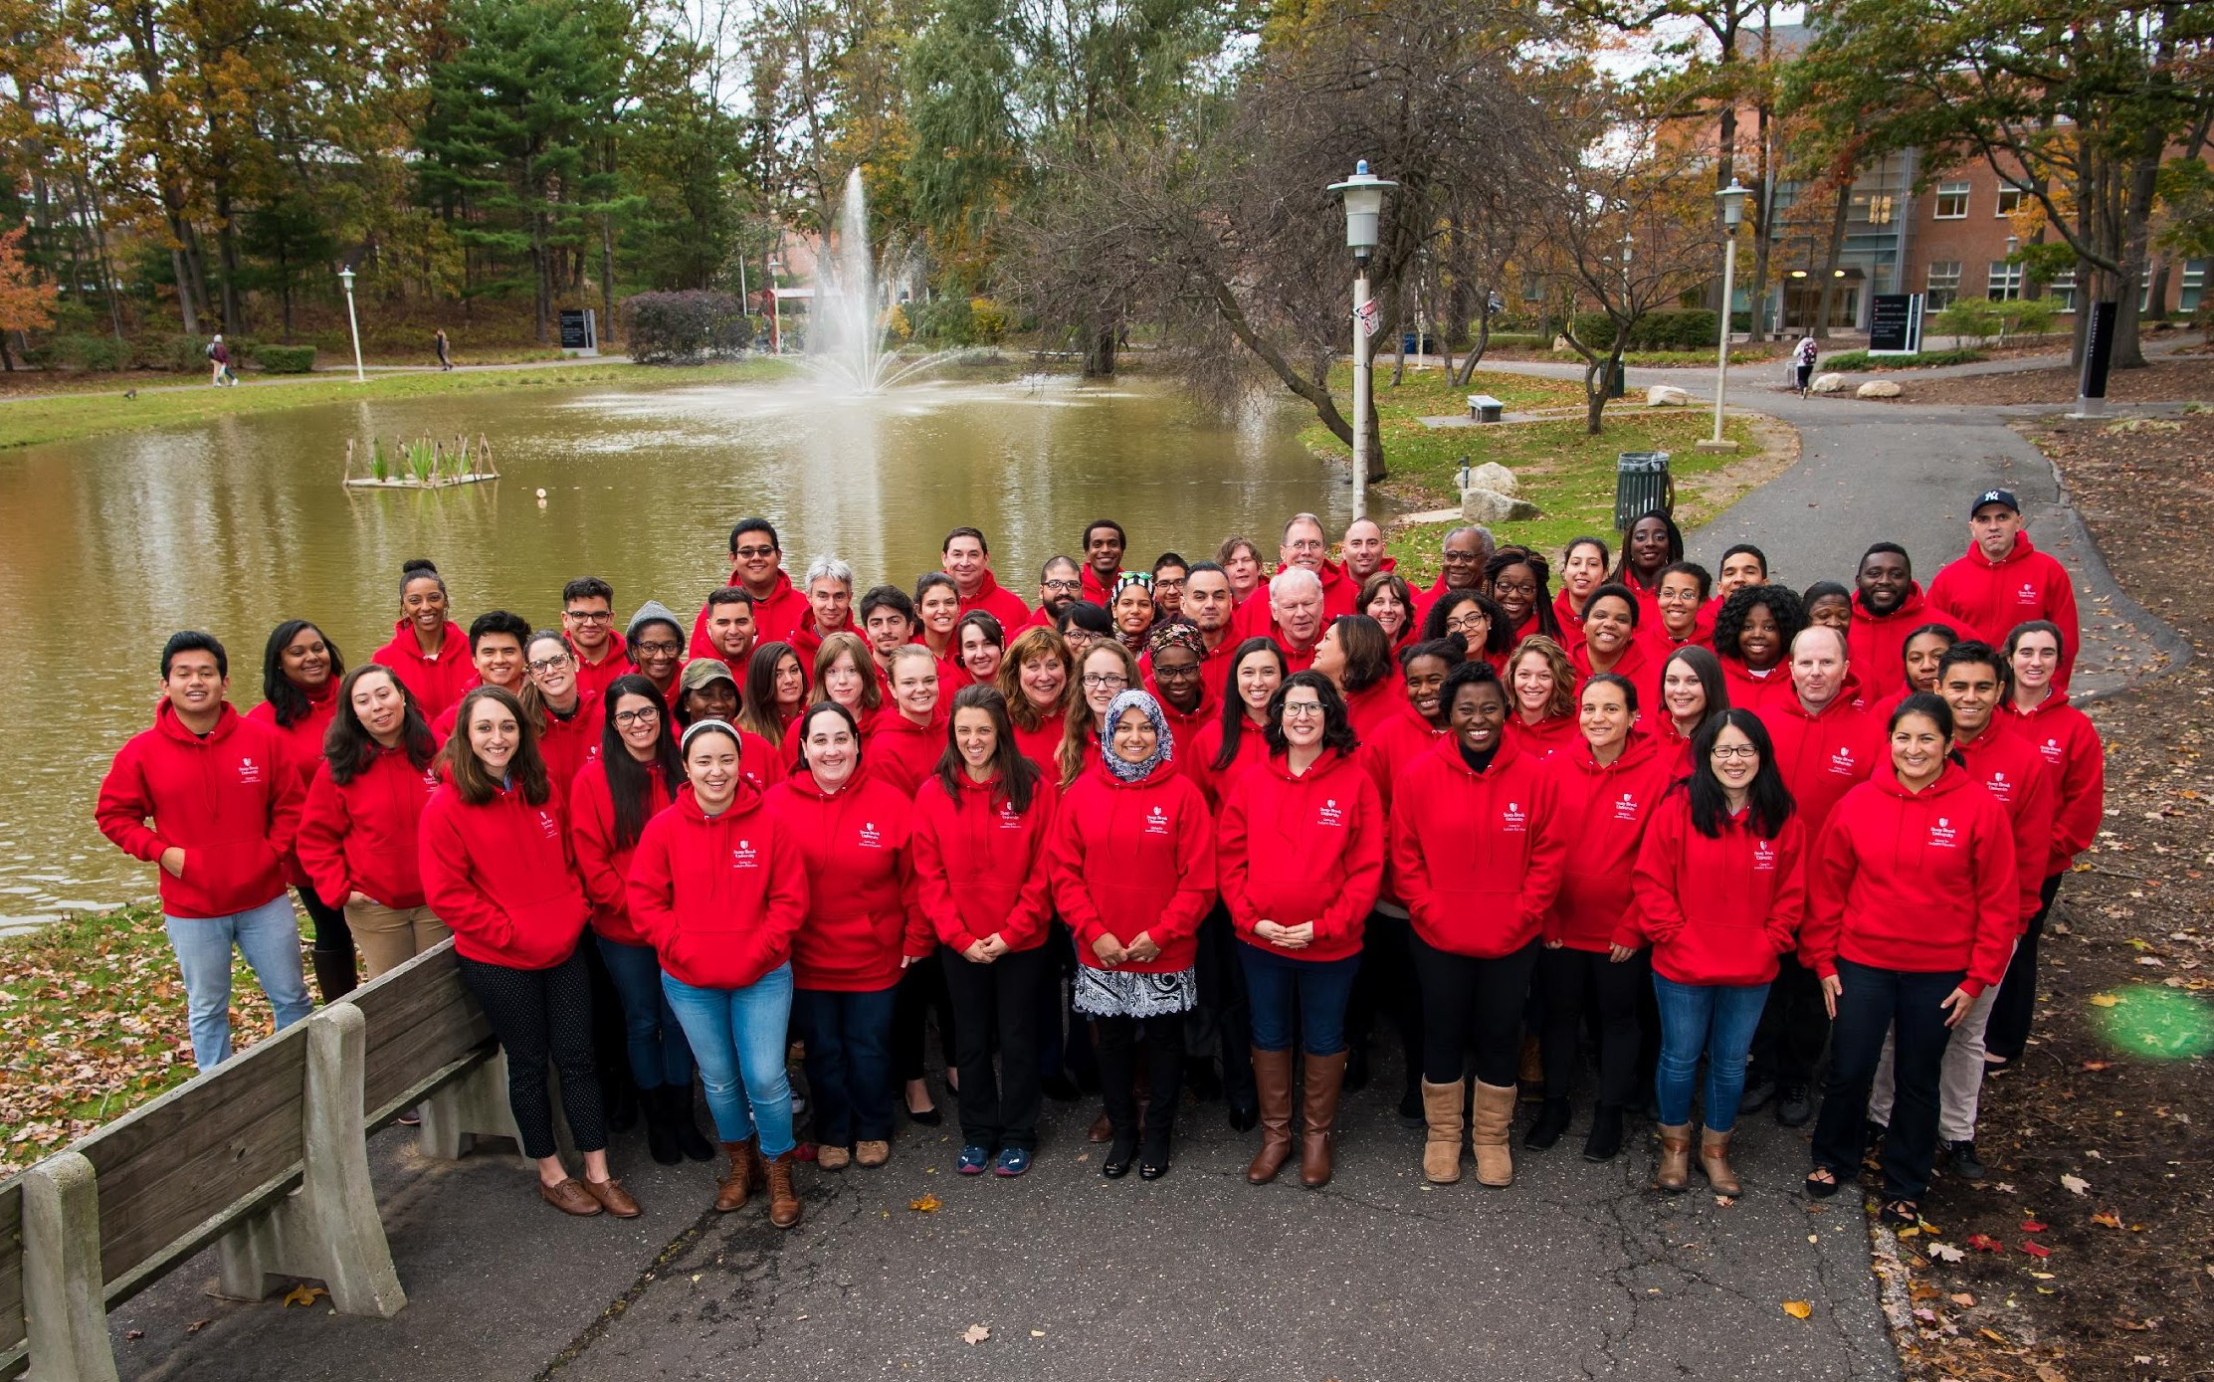


Thank you!
Center for Inclusive Education

